Slide 1
Class 9
BUS 696
Prof. Jonathan Hersh

Slide 2
BUS 696: Class 9 Announcements
Pset 7 solutions
Problem Set 8 Posted
Final Project
One sheet due today
Reminder: midterm exam next week
4-5 hours to do exam
Any other Qs?

Slide 3
BUS 696: Class 9 Outline
AI Would You Invest?
Regression Trees
Regression Trees in R
Example Test Q

Slide 4


Slide 5
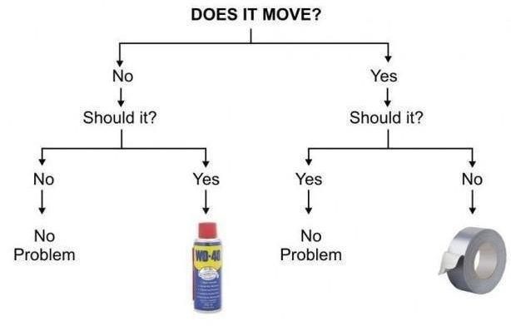
Binary Decision Rules

Slide 6
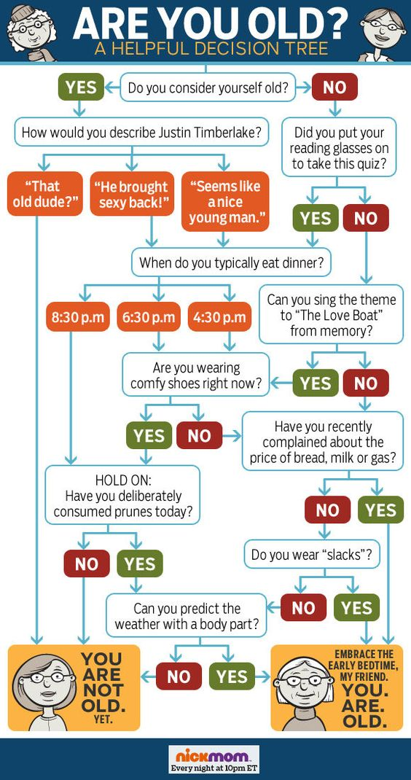
Classification Trees: Series of Binary Decision

Slide 7
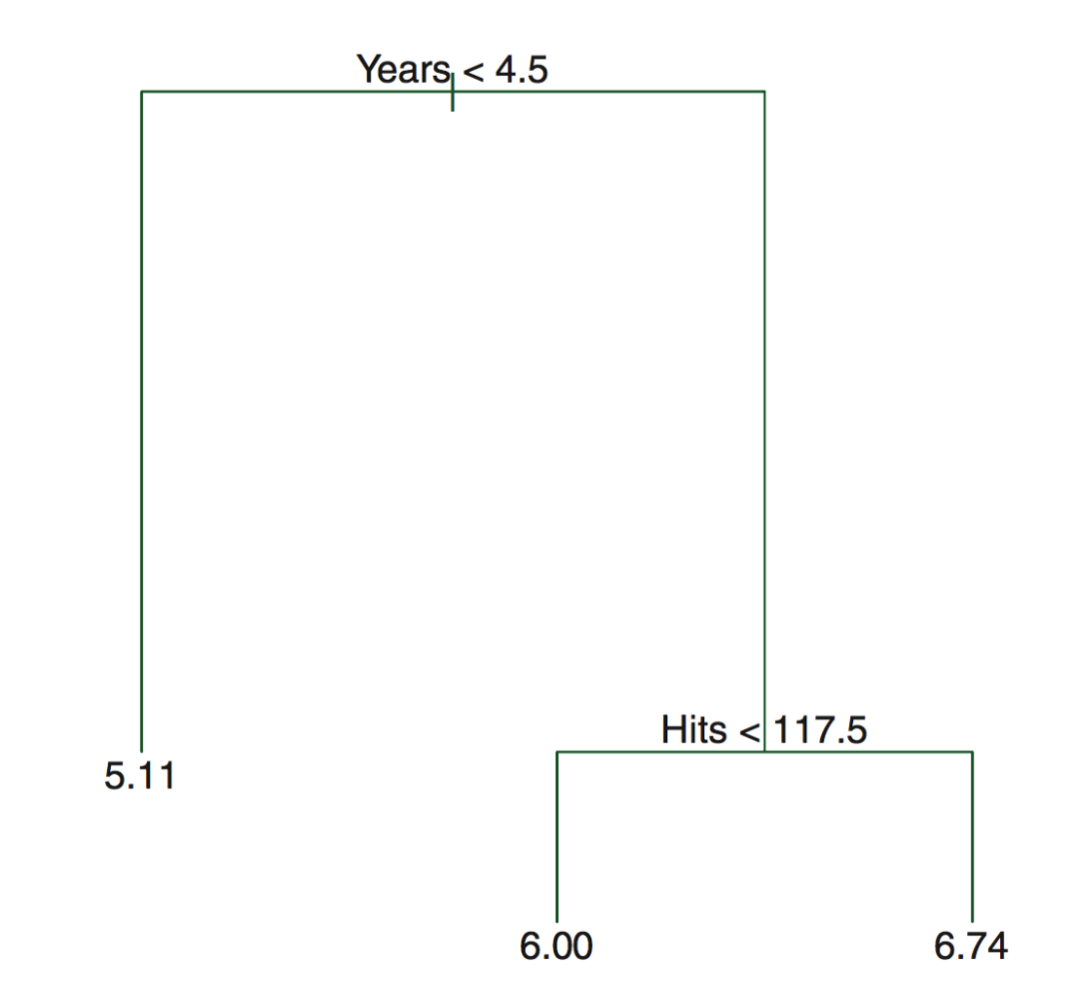
Regression Trees
Tree based methods stratify or segment the predictor space into different regions
Regions are stratified via simple rules
The splitting rules can be summarized into a tree that is very intuitive

Slide 8
Pros and Cons of Trees
Pros
Simple
Easy to interpret
Easy to explain
Can be displayed graphically!
Bagging, boosting, and random forests very powerful (combining trees)
Cons
Slow with large datasets
Not easy to use “out of the box”
Choice of split can be unstable

Slide 9
Decision/Regression Trees
Decision trees can be applied to both regression problems ($y_{i}∈R)$ and classification problems $y_{i}∈\{class1,class2,…,\}$
We’ll consider both

Slide 10
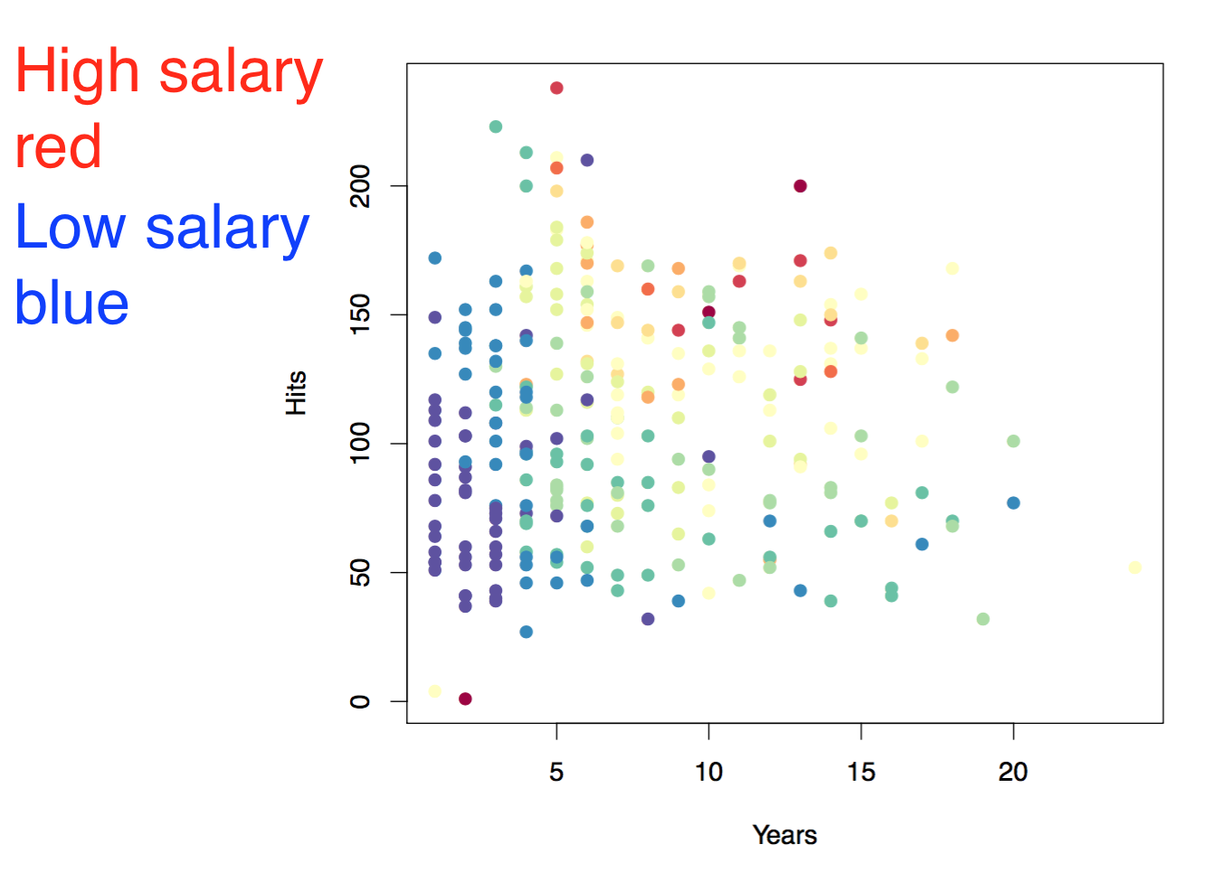
Baseball salary data: how to partition/stratify?

Slide 11
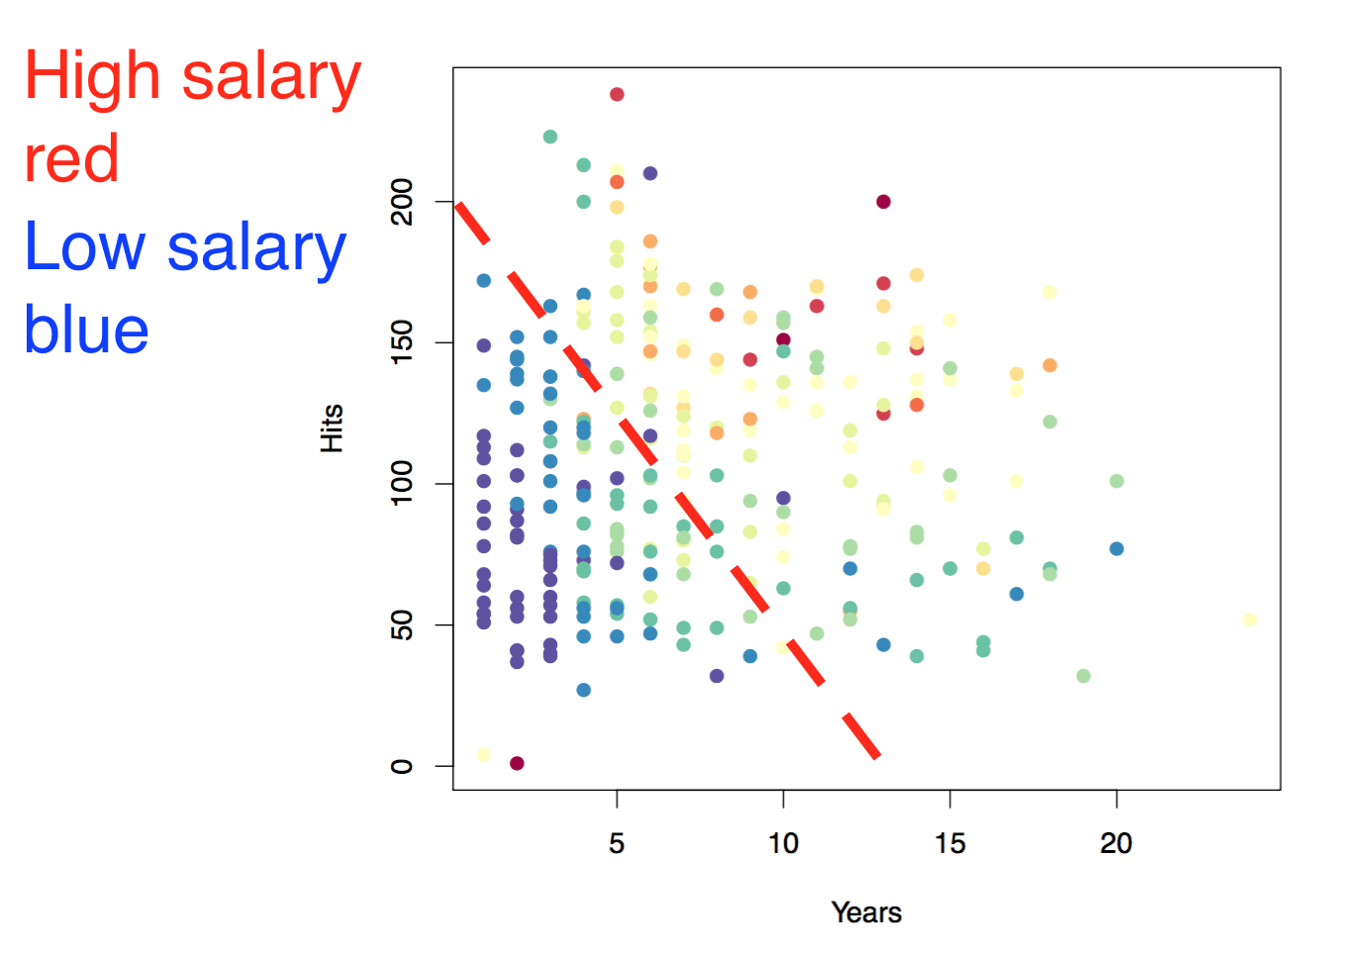
Baseball salary data: how to partition/stratify?

Slide 12
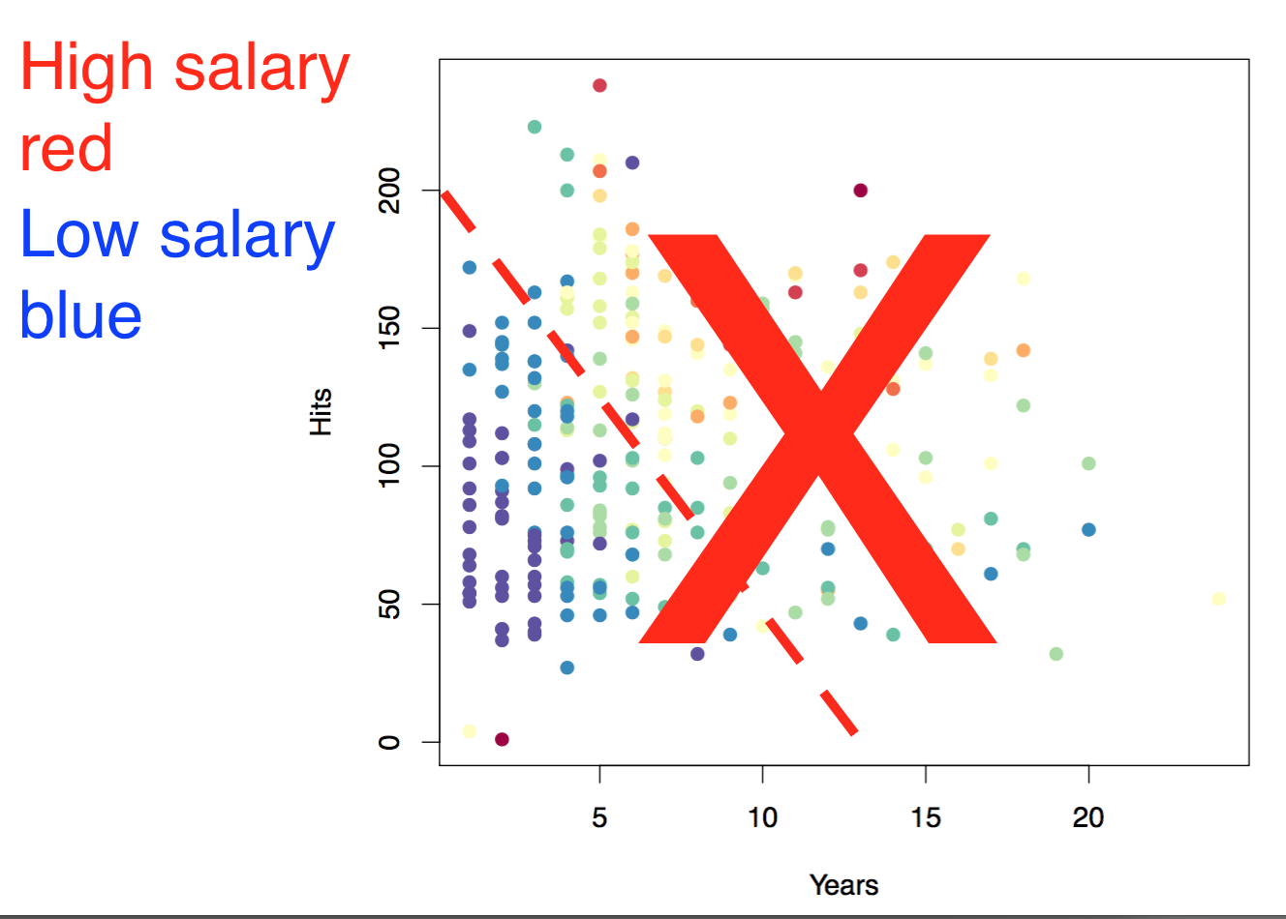
Baseball salary data: how to partition/stratify?
Only linear classification rules are allowed, e.g. year > 10

Slide 13
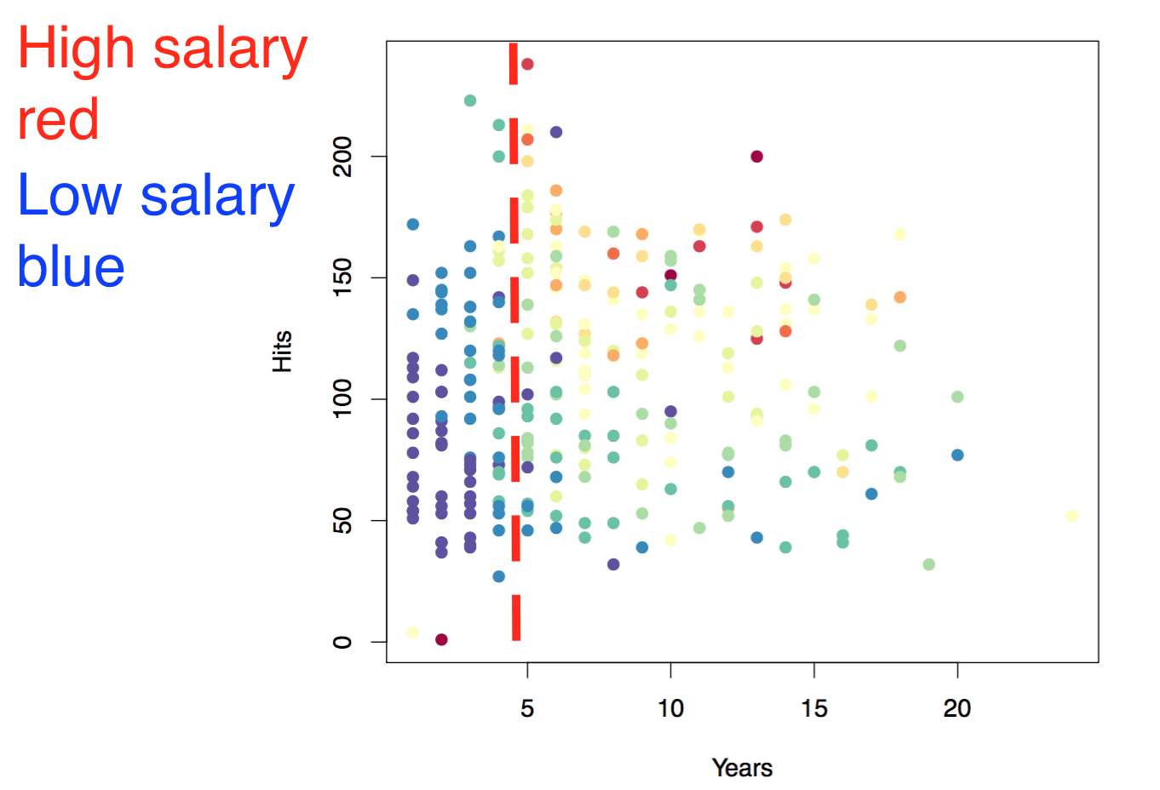
Baseball salary data: split 1
Split 1: years > 4.5

Slide 14
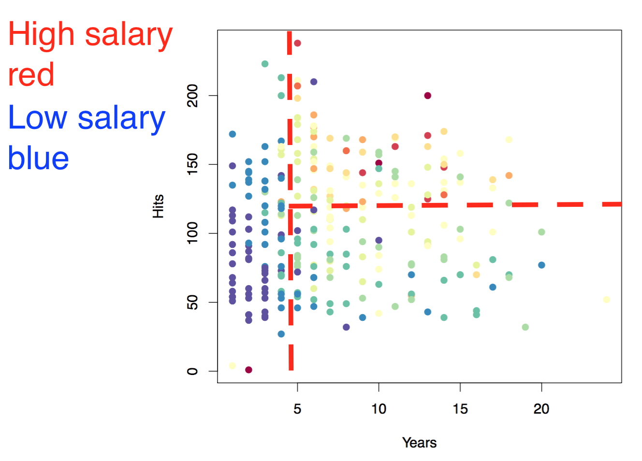
Baseball salary data: split 2
Split 1: years > 4.5
Split 2: hits > 117.5

Slide 15
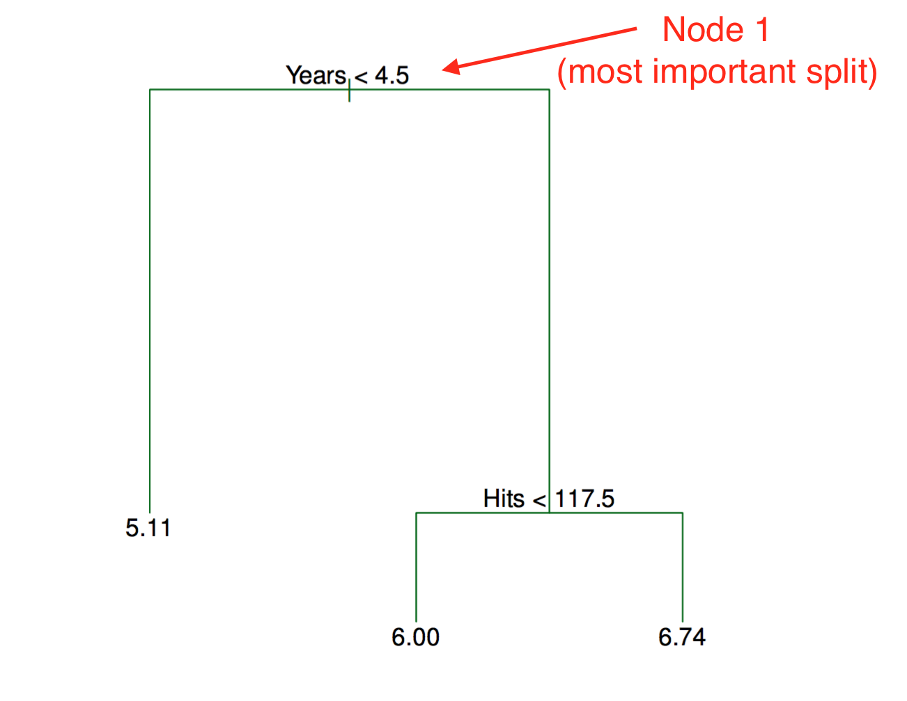
Tree Representation
Trees are read top-down
Most important split is at top
Length represents how much within-cluster variance decreases from split

Slide 16
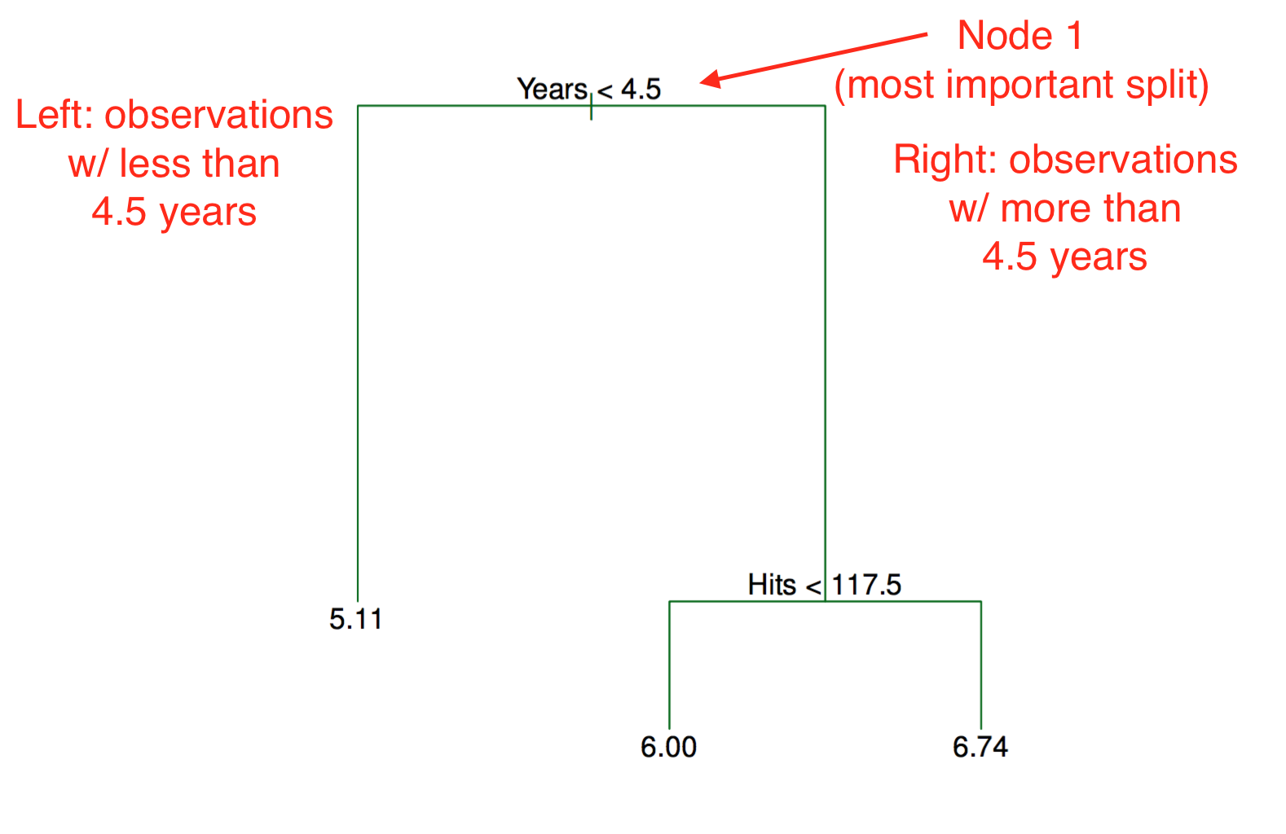
Tree Representation

Slide 17
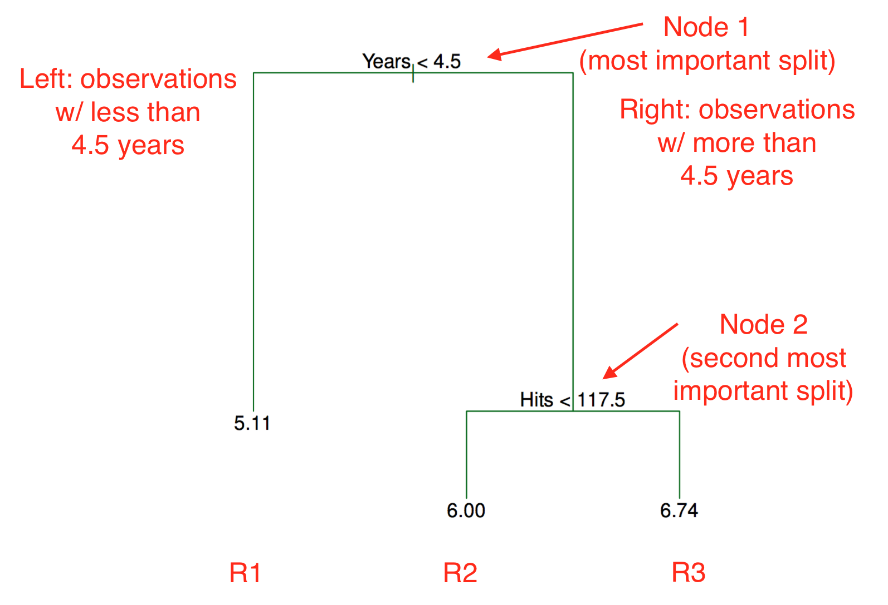
Tree Representation
At the end of the tree are “leafs”
For regression, avg value of observations in leaf => $\hat{y}$ for observation

Slide 18
Details of tree building algorithm
Computationally infeasible to consider all combinations of splits
Instead, use a top-down, greedy approach called recursive binary splitting
Greedy here means at each step, we only consider the best split, without caring how it affects successive nodes
“top down” because we start with the best split and proceed downward (no backing up)

Slide 19

Pruning trees
How do we know when to stop splitting the data?
Trees with many splits can overfit the data
Solution is to grow a large tree $T_{0}$, then prune it to obtain a smaller sub-tree

Slide 20
Decision tree algorithm (8.1 in ISLR)
Use recursive binary splitting to grow a large tree on the training data
Apply pruning to large tree to obtain sequence of subtrees, $α_{1}$, $α_{2}$
Use k-fold cross validation to find $\hat{α}$. For each k = 1, . . . ,K :
Repeat steps 1 and 2 on all but the k-th fold of training data
Evaluate mean squared prediction error on data in left-out k-th fold
Average the results for each value of $α$. Choose the value of $α_{}$ that minimizes error $α_{}$
Return the subtree that minimizes cross-validated error

Slide 21
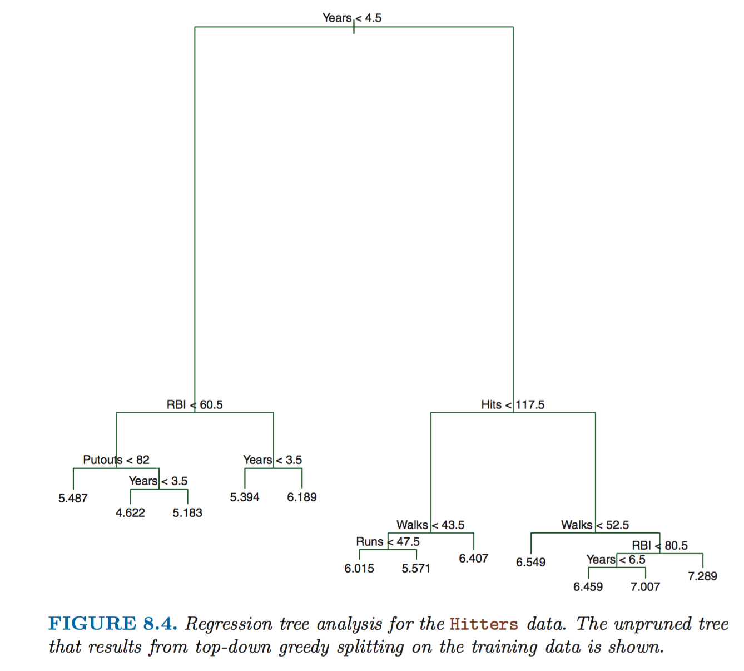
Baseball example, unpruned tree

Slide 22
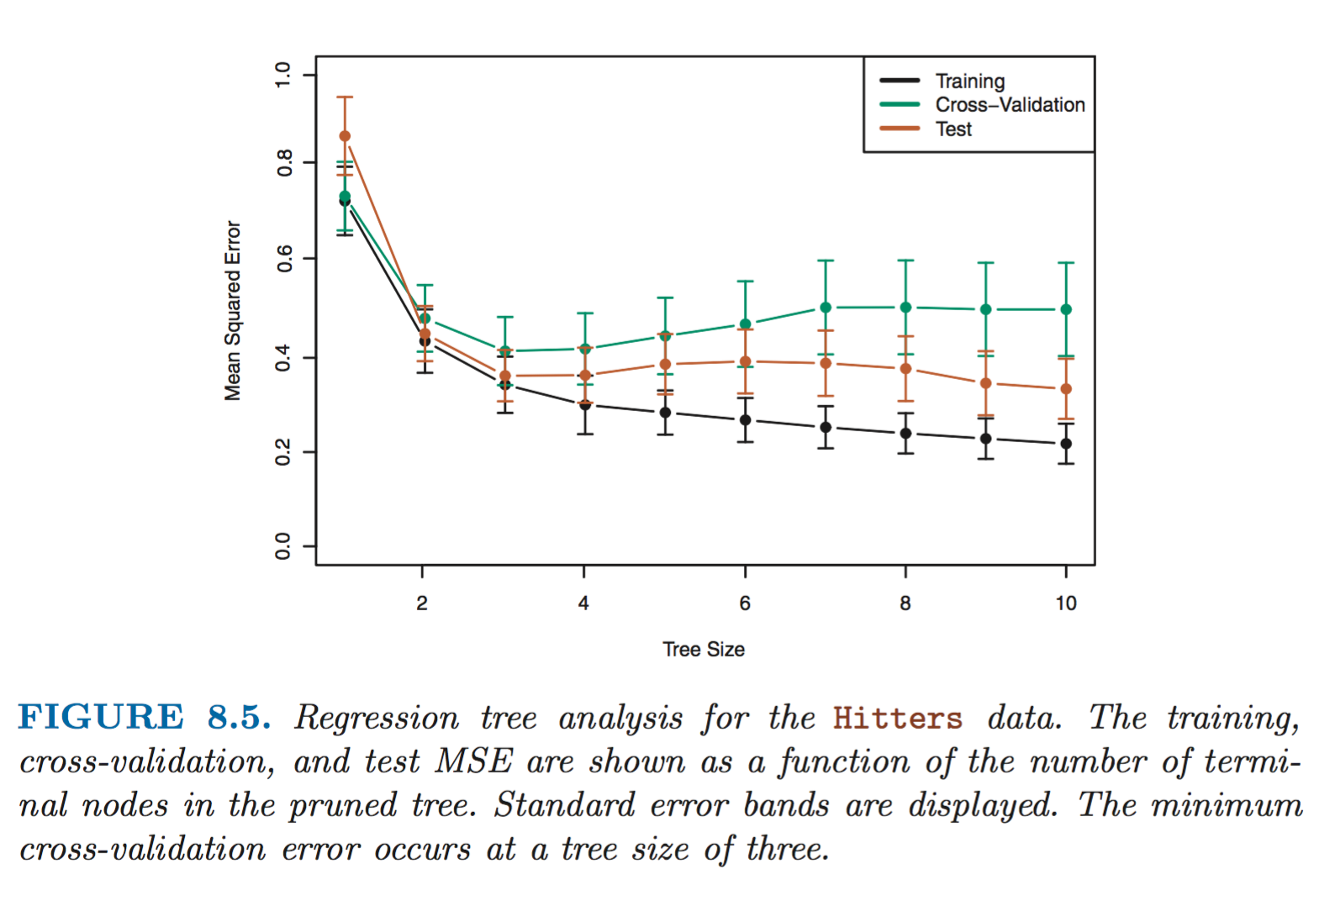
Cross-validate to find alpha

Slide 23
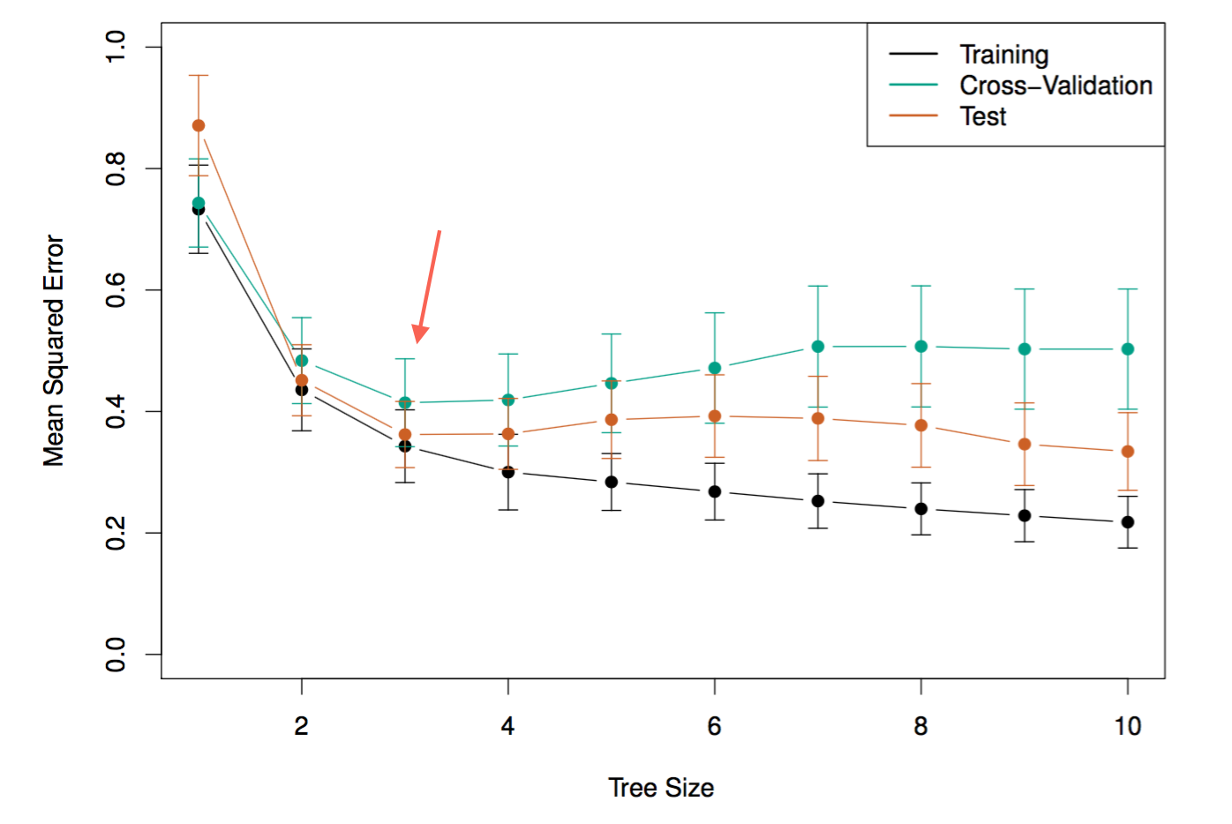
Cross-validate to find alpha

Slide 24
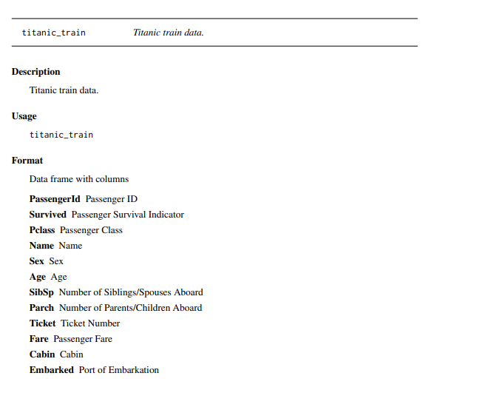
Titanic dataset in ‘titanic’ package

Slide 25
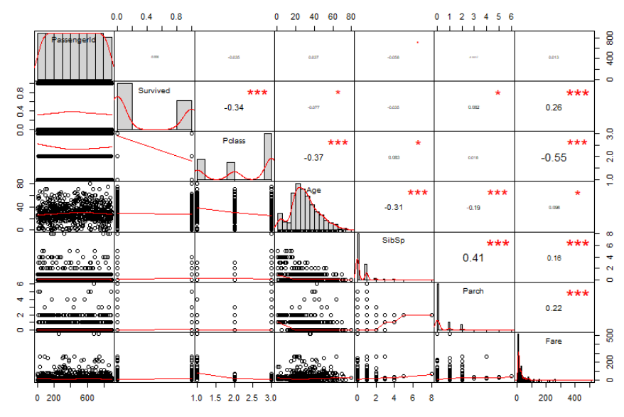
Titanic dataset in ‘titanic’ package

Slide 26
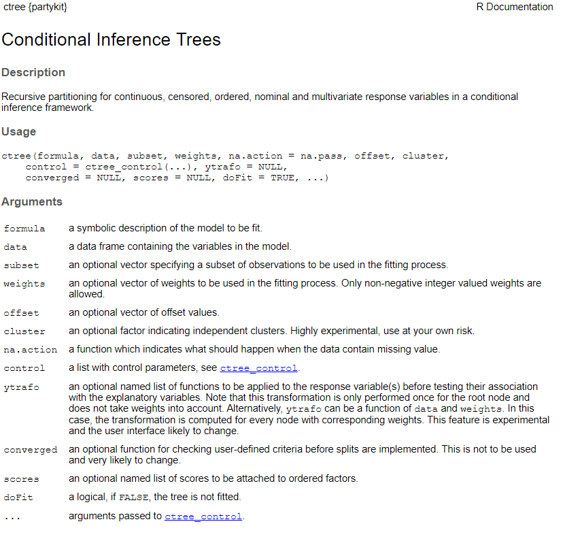
ctree() function in package “partykit” to build regression tree

Slide 27
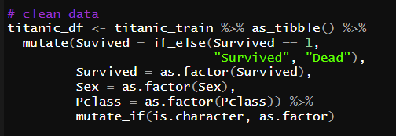
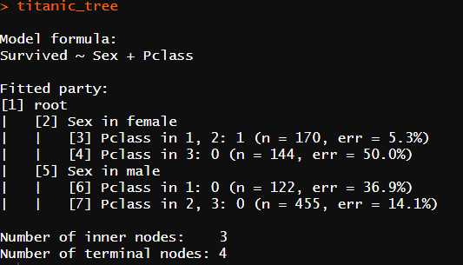

Estimate a tree model to predict titanic survival

Slide 28
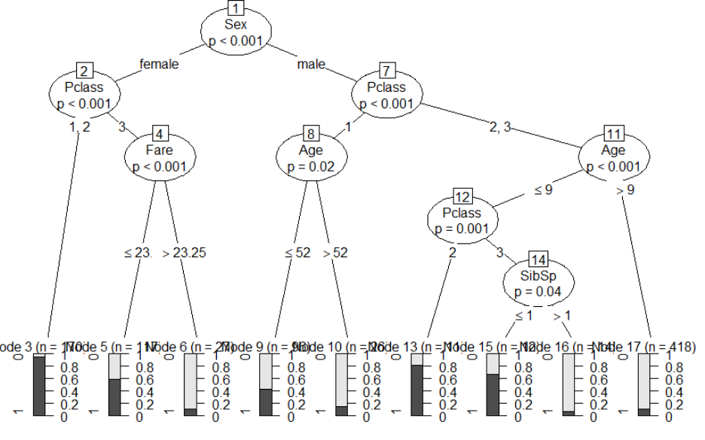
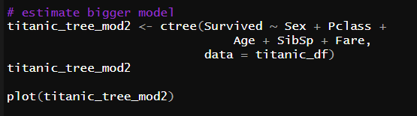
Estimate a tree model to predict titanic survival

Slide 29
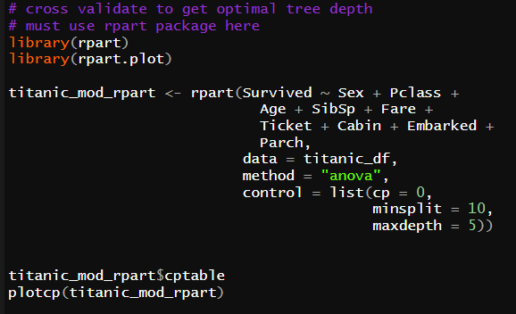
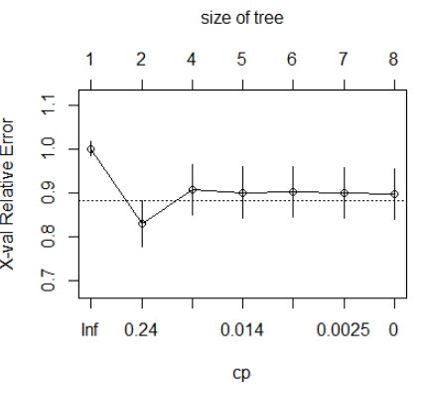
Cross –Validate to Determine Optimal Tree Depth

